Slide 1
CUSTOMER RELATIONSHIP MANAGEMENT
Pertemuan ke-5
SISTEM INFORMASI ENTERPRISE

Slide 2
The Basics of CRM
Timely delivery of excellent service
CRM is a combination of business process and technology that seeks to understand a company’s customers from a number of perspectives including:
Who they are?
What they do?
What do they like?
When competition is fierce, companies go back to basics: create value for customer
Only by integrating sales and service infrastructure with all aspects of operations can management see change in customer relationships
RNL - 2014

Slide 3
Top Demand Drivers in CRM
Telecommunications – Primary CRM applications include:
Multi-channel contact centers
Business intelligence
Customer data integration and analysis
Web-based billing systems
Marketing automation
Mobile CRM
Banking and Financial Services – Primary CRM applications include:
Profitability analysis
Target marketing
Data mining
Product personalization
Retail – Primary CRM applications use e-commerce transaction and point-of-sale data to drive:
One-to-one marketing
Cross selling
Personalized content management and merchandizing

Slide 4
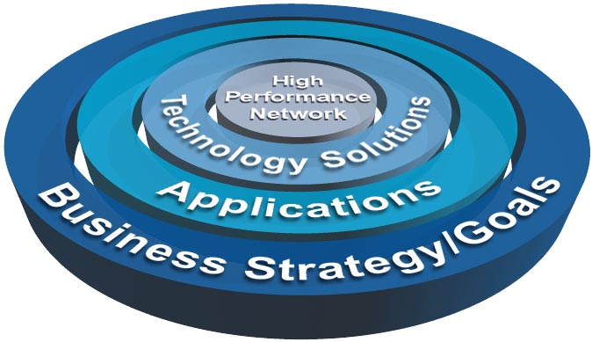
Defining CRM (1)
CRM is :
The approach of identifying, establishing, maintaining, and enhancing lasting relationships with customers.
The formation of bonds between a company and its customers.
A business strategy to select and manage customers to optimize long-term value.
An integrated approach to identifying, acquiring and maintaining customers.
Allows companies to coordinate their approach across channels, departments and also geographically.

Slide 5
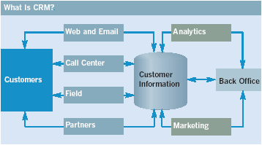
Defining CRM (2)
An integrated sales, marketing and service strategy that is based on a timely and accurate information infrastructure and that depends on coordinated enterprise-wide activities
Example: tracking customers interactions with the firm
Customer tracking includes steps in the selling and customer service cycles

Slide 6
Traditional Marketing vs CRM
Traditional Marketing | CRM
Goal: Expand customer base, increase market share by mass marketing | Goal: Establish a profitable, long-term, one-to-one relationship with customers; understanding their needs, preferences, expectations
Product oriented view | Customer oriented view
Mass marketing / mass production | Mass customization, one-to-one marketing
Standardization of customer needs | Customer-supplier relationship
Transactional relationship | Relational approach

Slide 7
CRM Key Benefits
Deeper understanding of customers
Increased marketing and selling opportunities
Identifying the most profitable customers
Making it easier for sales and channel partners to sell
Faster response to customer inquiries
Increased efficiency through automation
Receiving customer feedback that leads to new and improved products or services
Obtaining information that can be shared with business partners
RNL - 2014

Slide 8
The Customer Life Cycle
Acquire
Differentiation
Innovation
Convenience
Bundling
Reduce Cost
Customer Service
Adaptability
Listening
New Products
Enhance
Retain

Slide 9
Framework for CRM
Identify prospects and customers
Differentiate customers by needs and value to company
Interact to improve knowledge
Customize for each customer
RNL - 2014

Slide 10
The New CRM Architecture: Organizing around the Customer
Customer Lifecycle
Acquire
Enhance
Retain
{
Direct Marketing
Cross-Sell & Up-Sell
Proactive Service
Partial Functional Solutions
Sales Force Automation
Customer Support
Complete Integrated Solutions
Integrated CRM Applications
Cross-Functional Processes Breaking Down Departmental Walls
RNL - 2014
Notes:
To determine how CRM and supporting tech will work together for your firm, ask these questions
Are most of company’s apps designed simple to automate existing departmental processes?
Are these apps capable of identifying and targeting best customers, those who are the most profitable?
Are these apps capable of real-time customization of products and services?
Do these apps track when the customer contacts the company, regardless of the contact point?
Are these apps capable of creating a consistent user experience across all contact points the customer chooses?
If answers to each is no, seriously consider CRM architecture

Slide 11
Features of the New CRM Architecture
Integrates solutions spanning entire customer life cycle
Proactive marketing
Customer care
Call centers
Automated transaction management capabilities
Personalization and one-to-one marketing
Customer analytics and business intelligence
Field sales automation
RNL - 2014

Slide 12
The Relationship Between Operational CRM and Analytical CRM
Customer-facing Applications
Customer
Data
Warehouse
Sales
Marketing
Customer Service and Support
Customer-touching Applications
Search and Comparison
Customized Products
Technical Information
Personalized Web Pages
FAQ
E-mail / Auto Response
Loyalty Programs
Data Mining
Decision Support
Business Intelligence
OLAP
Notes:
Operational CRM
Products, services and operational capabilities that enable the organization to take care of its customers.
Examples: contact centers, data aggregation system, and web sites.
Analytical CRM
Strategies and tools that drive customer-centric business decisions.
Examples: business intelligent systems, data mining tools, and customer-tier strategies.

Slide 13
The Players
The Top 11 CRM Manufactures Are:
Company Product name
1. Microsoft Microsoft Dynamics CRM 3.0
2. Sage Software SalesLogix CRM
3. SAP America Inc. SAP Business One CRM
4. Parature Inc. Parature
5. Entellium Entellium CRM
6. Pivotal corp. Pivotal CRM
7. Maximizer Software Maximizer Enterprise CRM
8. Netsuite Inc. NetSuite CRM+
9. Oncontact Software Oncontact V
10. ADAPT Software Applications ADAPT crm
11. Exact Software North America e-Synergy
RNL - 2014
Notes:
Categories of CRM
Marketing automation
Sales automation
Service and service fulfillment
Customer self-service
E-commerce

Slide 14
Studi kasus
🎯 Latar Belakang Masalah:
Toko Online XYZ mengalami penurunan dalam pembelian ulang oleh pelanggan lama. Manajemen ingin mengetahui faktor-faktor yang memengaruhi loyalitas pelanggan serta mengidentifikasi pelanggan yang potensial untuk ditargetkan kembali.

Slide 15
tujuan
📊 Tujuan:
Menganalisis perilaku pembelian pelanggan.
Mengukur kepuasan pelanggan dari data feedback.
Mengidentifikasi segmen pelanggan berdasarkan nilai pembelian.
Menyediakan visualisasi interaktif untuk pengambilan keputusan.

Slide 16
dataset
🗂️ Dataset yang Digunakan (contoh data simulasi):
Data Pelanggan: ID, Nama, Usia, Jenis Kelamin, Lokasi.
Data Transaksi: ID Transaksi, ID Pelanggan, Tanggal Pembelian, Total Pembelian, Kategori Produk.
Data Feedback: ID Pelanggan, Skor Kepuasan (1–5), Komentar.
Data Loyalty Program: ID Pelanggan, Poin, Status Loyalitas (Silver/Gold/Platinum).

Slide 17
analisis
🔍 Analisis yang Dilakukan:
RFM Analysis (Recency, Frequency, Monetary):
Mengelompokkan pelanggan ke dalam kategori: Loyal, Potensial, Butuh Perhatian, dll.
Visualisasi dengan Power BI menggunakan chart, matrix, dan slicer.
Customer Segmentation:
Segmentasi berdasarkan demografi (usia, jenis kelamin) dan lokasi.
Analisis tren pembelian berdasarkan waktu (bulan/tahun).
Customer Satisfaction Dashboard:
Visualisasi skor rata-rata kepuasan pelanggan.
Korelasi antara skor kepuasan dan total pembelian.
Sales Funnel dan Retention:
Identifikasi konversi dari pelanggan baru → loyal.
Analisis pembelian berulang.

Slide 18
insight
🧩 Insight yang Diharapkan:
Siapa saja pelanggan paling loyal?
Faktor apa yang membuat pelanggan tidak membeli kembali?
Area mana yang paling potensial untuk promosi?
Apakah program loyalitas berdampak signifikan terhadap penjualan?

Slide 19
Link dataset (latihan)
✅ 1. Sumber Dataset Publik (Gratis dan Siap Pakai)
🔹 Kaggle (https://www.kaggle.com)
Cari: "Ecommerce Customer Dataset", "Online Retail", "Customer Segmentation", "Sales CRM"
Contoh dataset:
Online Retail Dataset : https://www.kaggle.com/datasets/mashlyn/online-retail
E-Commerce Data https://www.kaggle.com/datasets/carrie1/ecommerce-data
Customer Personality Analysis : https://www.kaggle.com/datasets/imakash3011/customer-personality-analysis

Slide 20
Dataset (latihan)
🔹 Microsoft Power BI Sample Datasets
Link: https://learn.microsoft.com/en-us/power-bi/create-reports/sample-datasets
Contoh: Customer Profitability Sample, Retail Analysis Sample
🔹 UCI Machine Learning Repository
Link: https://archive.ics.uci.edu
Cari: dataset seperti Online Retail, Customer Behavior, Sales Data.

Slide 21
Materi UAS
Data warehouse
Data multidimensional
GDSS
Sistem Informasi Enterprise
ERP
CRM
Tugas besar dengan PowerBI
Praktek/latihan
Catatan : open catatan 1 lembar bolak balik

